Slide 1
The Legend of a Knight – Predjama Castle
PRIMARY SCHOOL IVAN CANKAR LJUTOMER
CLASS: 7. a
Program Popestrimo šolo 2016-2021 sofinancirata Ministrstvo za šolstvo Republike Slovenije in Evropski socialni sklad.

Slide 2
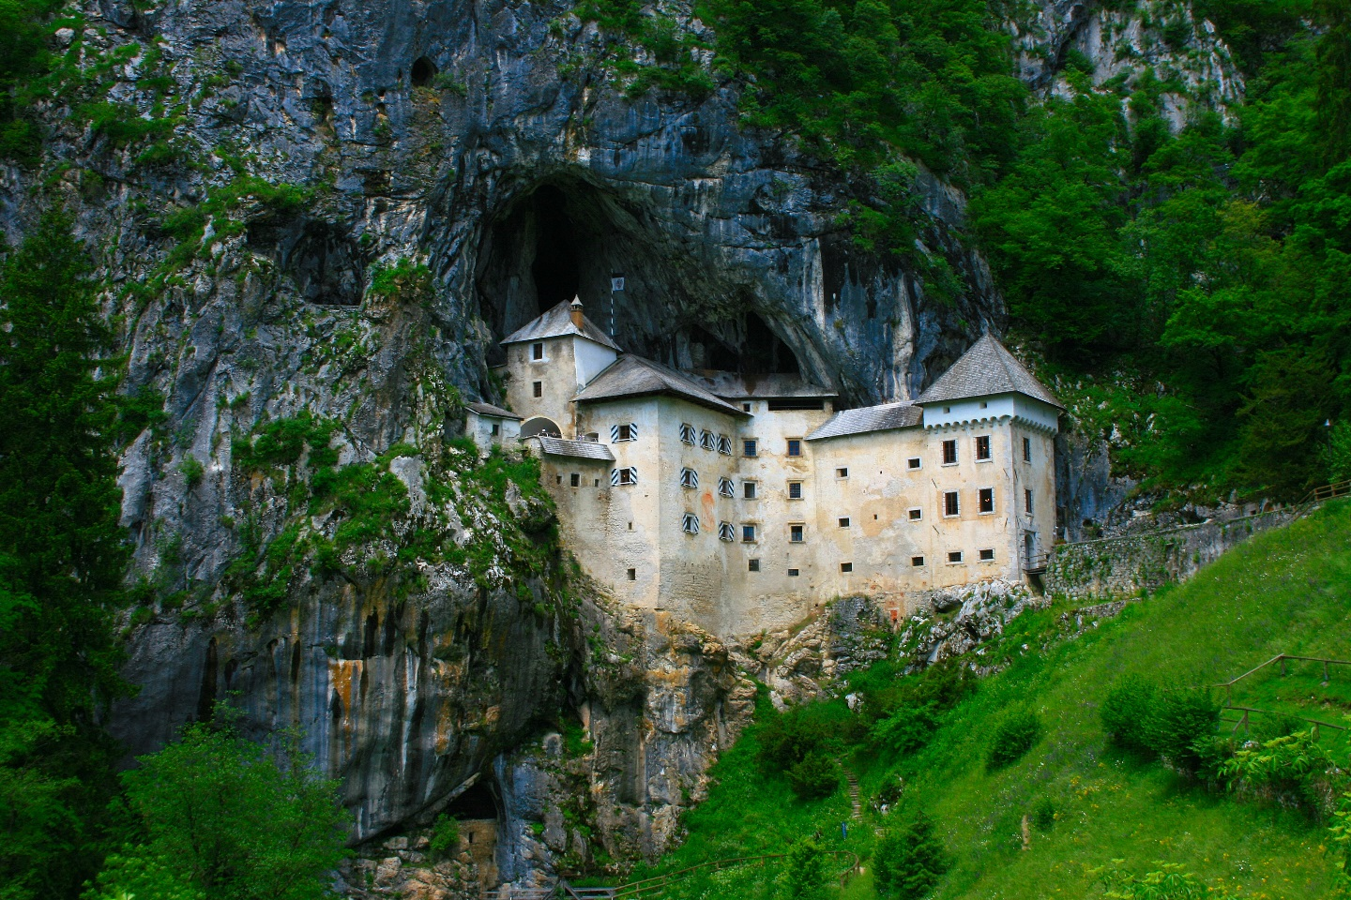
Not far from Postojna stands a mysterious Predjama Castle. It‘s been standing there for more than 800 years. This is also one of the locations where Jackie Chan movie Armour of gold was shot. It is also listed in the Guinness World Records as the largest cave castle in the world.

Slide 3
Sometimes it is hard to distinguish where the natural stone ends and human made walls begin. Its architecture provided a safe place during the siege and a valuable storage for food and source of drinking water. The secret passage was of a great advantage when being surrounded by enemies.
There exist interesting stories about Erazem of Predjama, the most famous owner of the castle that lived in 15th century. The legend of a brave robber baron, who took from rich merchants and gave to poor, a Slovenian Robin Hood. When surrounded by enemies who chose to await and defeat him by starving him, he smuggled food from the valley on the other side of the hill. To mock the enemy, he sent them the cherries from the castle, which happened in the beginning of spring, where bringing cherries seemed as a magic trick, since it was still too early for cherries to grow. Surprised opponent didn’t know the cherries came from neighboring valley, with warmer weather where the cherries were already ripe. Unfortunately, a servant betrayed Erazem and he didn’t withstand that siege.

Slide 4
ERAZEM OF PREDJAMA

Slide 5
In the tour through castle chambers and rooms you can see the bedrooms, living spaces and objects needed at the time, be it weapons or kitchen supplies. In warmer months one can also visit the cave under the Predjama Castle which is inhabited by numerous bats and offering fascinating views. To imagine the medieval life even better, there is the Erazem’s Knight Tournament that is bringing the legend of brave baron to life. At this event the medieval dances and music are presented, and games with fire are shown, that can take you hundreds of years in the past.

Slide 6
